Slide 1


Community Detection Case Study
Social Network Analysis
Topic: Clustering Influencer–Follower Communities on Instagram Using Spectral Embedding + KMeans
By:
Prithika S (RA2211003010045)
Bharath Kalyan DKR (RA2211003010064)
Bhavan Kalyan DKR (RA2211003010068)

Slide 2
Background & Motivation
• Instagram has 2B+ active users
• Micro-influencers drive higher engagement
• Brands need tools to identify niche influencer communities
• Engagement-based community detection can solve this problem

Slide 3
Problem Statement & Objective
Objective:
Automatically detect and cluster influencer–follower communities on Instagram using engagement data.
Benefits:
• Identify micro-influencer networks
• Provide marketing insights
• Understand audience behavior

Slide 4
Functional Workflow
1. Data Collection (Likes, Comments, Shares)
2. Preprocessing (Cleaning, Normalizing)
3. Graph Construction (Adjacency Matrix)
4. Spectral Embedding (Eigenvectors of Laplacian)
5. KMeans Clustering
6. Identify & Rank Influencers

Slide 5
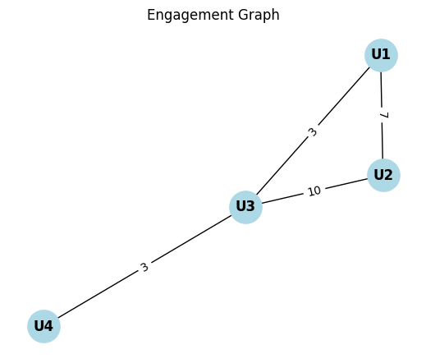
Data Collection & Graph Construction
• Nodes: Instagram Users
• Edges: Engagement score (weighted likes, comments, shares)
• Build Adjacency Matrix (A)
• Construct Degree Matrix (D)
• Graph Laplacian: L = D – A
Where:
A = adjacency matrix
D = degree matrix (Dii=∑jAij​)

Slide 6
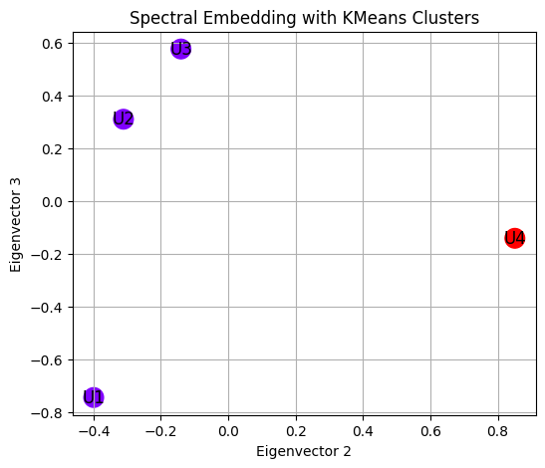
Spectral Embedding
• Solve eigenvalue problem: Lx = λx
• Select k smallest eigenvectors
• Form matrix U (n × k)
• Map users into low-dimensional space

Slide 7
KMeans Clustering
• Input: Spectral embedding matrix U
• Minimize: Within-cluster variance
• Output: k influencer–follower communities
• Each cluster ≈ micro-influencer network
KMeans Objective:
min⁡C1,...,Ck∑i=1k∑x∈Ci∣∣x−μi∣∣2
Where μi​ is the centroid of cluster i.

Slide 8
Worked-Out Example
4 Users → Engagement Matrix → Adjacency Matrix → Laplacian
Eigenvectors → Clusters:
Cluster 1: (U1, U2)
Cluster 2: (U3, U4)
Visualize communities with different colors.

Slide 9
Applications & Insights
• Brands: Select relevant influencers for campaigns
• Influencers: Understand most engaged audience segments
• Researchers: Study network dynamics and information spread

Slide 10
Conclusion & Future Scope
Conclusion:
Spectral Embedding + KMeans is effective for influencer–follower community detection.
Future Enhancements:
• Time-based analysis (emerging influencers)
• Sentiment-aware clustering
• Multi-platform integration

